Slide 1
Landslides in Oregon
By: William Bartholomew

Slide 2
Problem statement
How many landslide events that took place within 100m of highways in Oregon resulted in repair costs exceeding $1 million between the years 2001-2005?

Slide 3
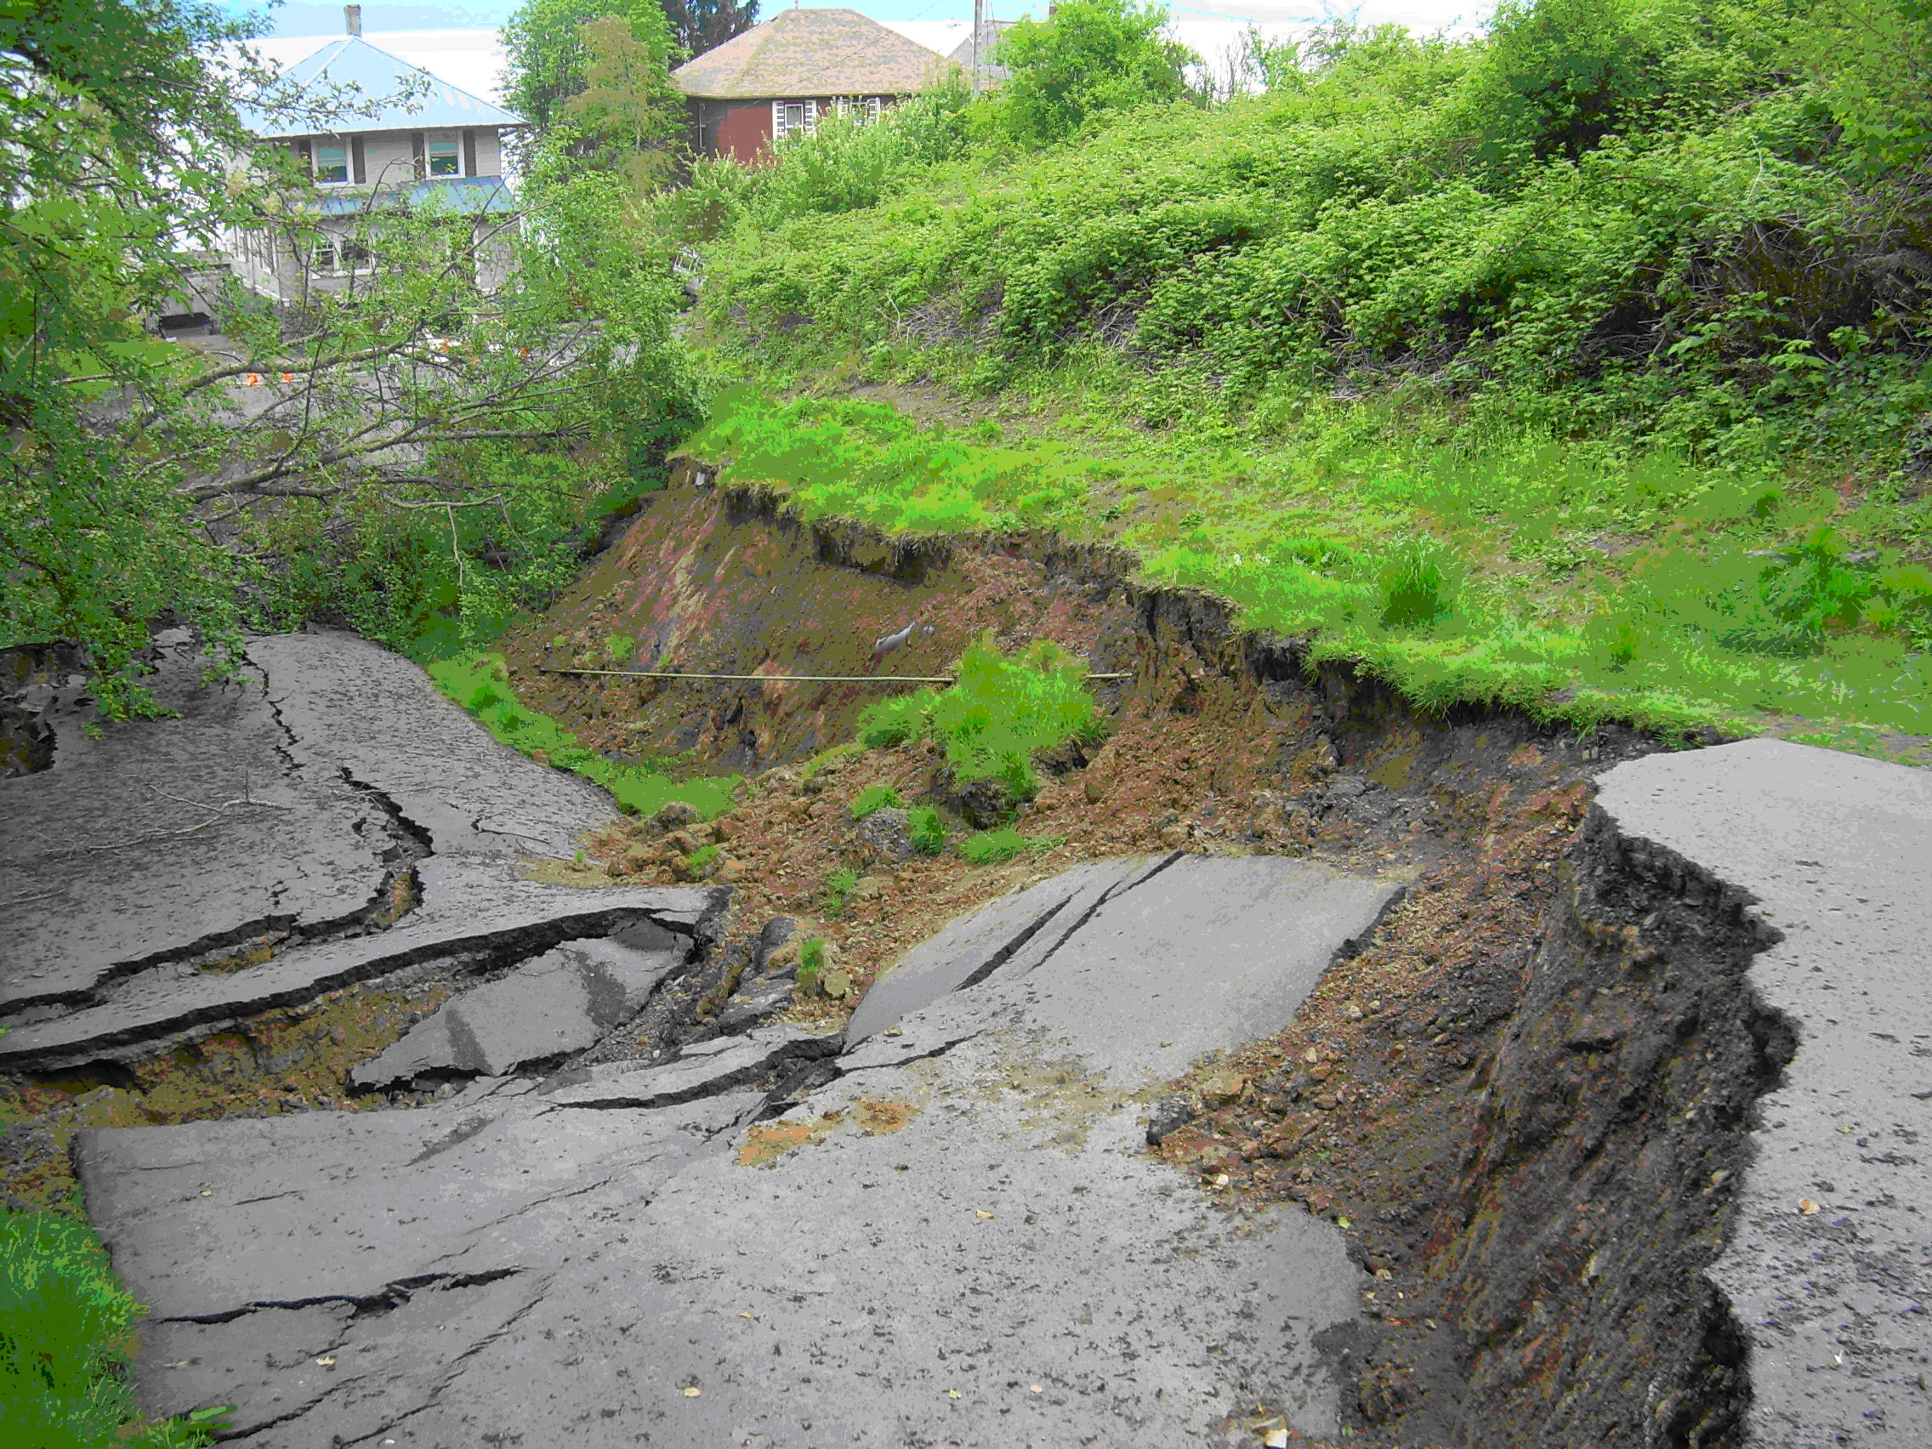
What is a landslide?
Landslides are defined as the downslope movement of rocks, soil or other related debris
The primary driving force for a landslide is gravity, but there are a multitude of other factors that affect the stability of a slope, such as: erosion at the toe of a slope, deforestation compromising the stability of a slope, vibrations from traffic, machinery or earthquakes

Slide 4
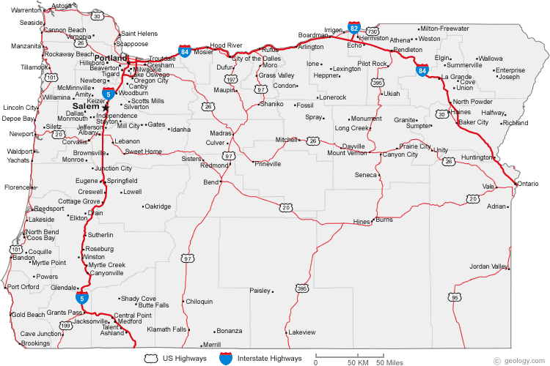
Landslides in Oregon
Landslides remain one of the most common geologic hazards in OR
Annual repair costs for landslides can exceed $10 million
Population growth has led to the development of more landslide prone areas, resulting in an increase of planning and action on all levels of community, from state government to individual families

Slide 5
Methods
Data for the map was collected from the Oregon Spatial Data Library
A separate file called “Final_Project_Data” was created to house all my data and work
The coordinate system for each layer was changed to “NAD_UTM_Zone10” in order to preserve distance as that was an important aspect to the project
Isolated data for landslide events that fit under the requirements of “repair costs exceeding $1 million” and “within 100m of highways” by using both ‘Select by Attributes’ and ‘Select by Location’

Slide 6
Methods
Gave a more specific idea of how much each landslide event cost by specifying the attribute table of the repair costs shapefile
Created 3 break points in the prices range: $1 million- $3999999, $4 million- $6 million, >$6 million
Created a new row within attribute table to match these break points with the repair costs row, so that when the events were symbolized, the correct symbol would be used
Created four separate shapefiles for four ‘Areas’ (which were based around Oregon’s counties) in order to narrow in on the landslide events around Oregon

Slide 7
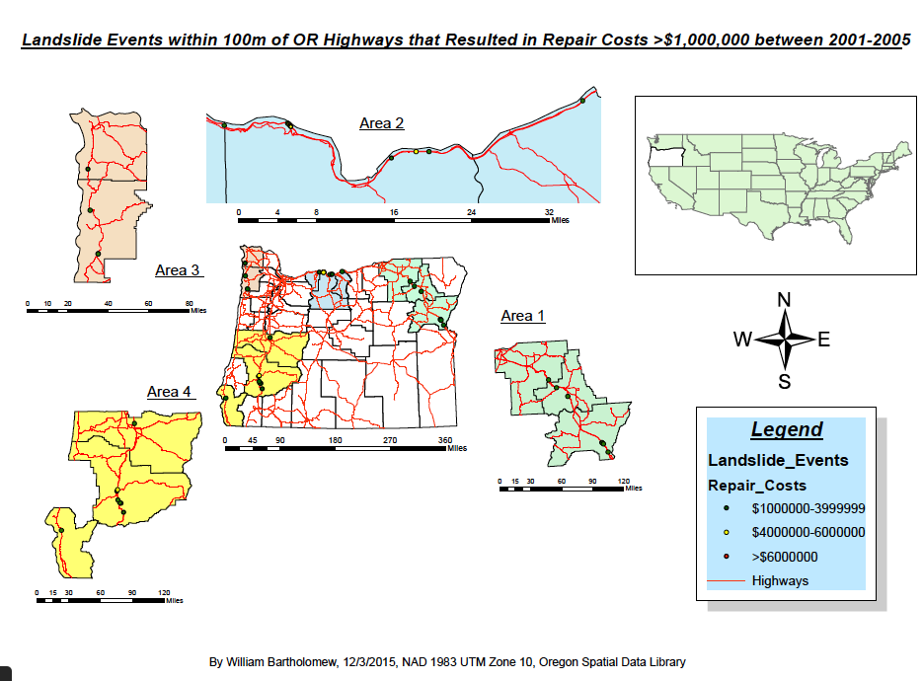

Slide 8
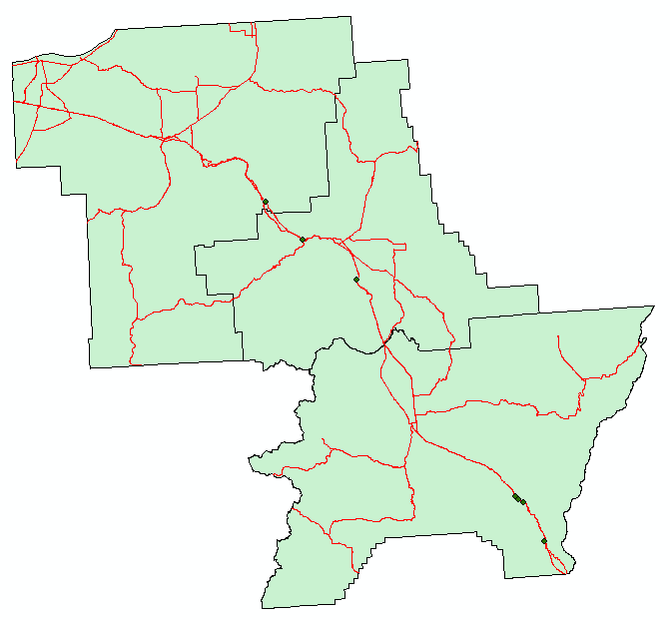

Slide 9
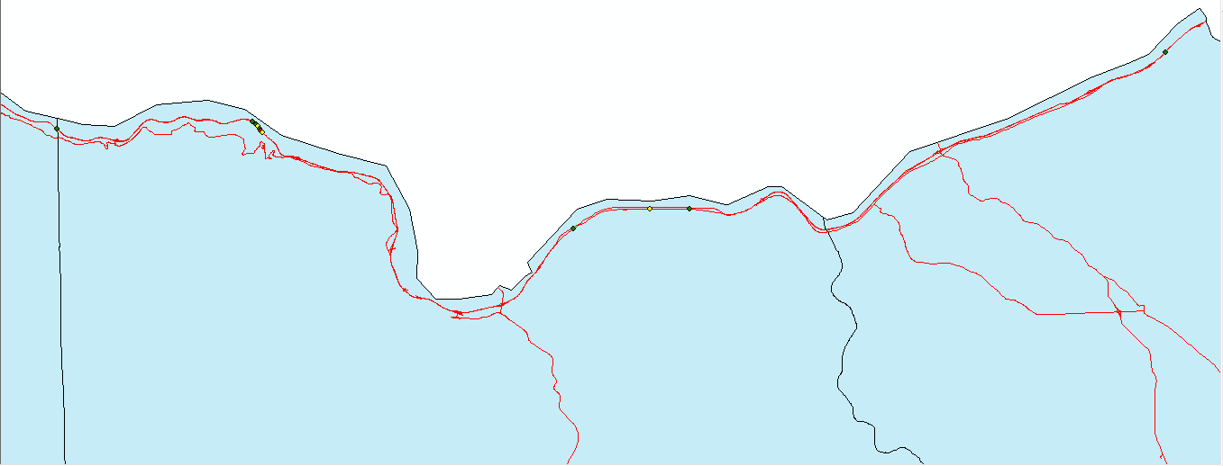

Slide 10
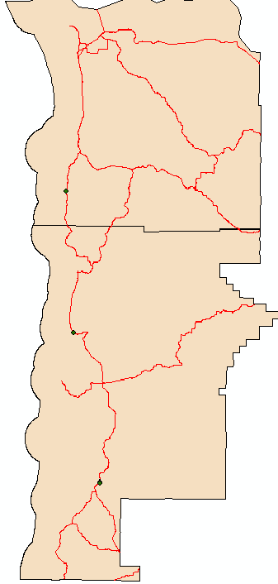

Slide 11
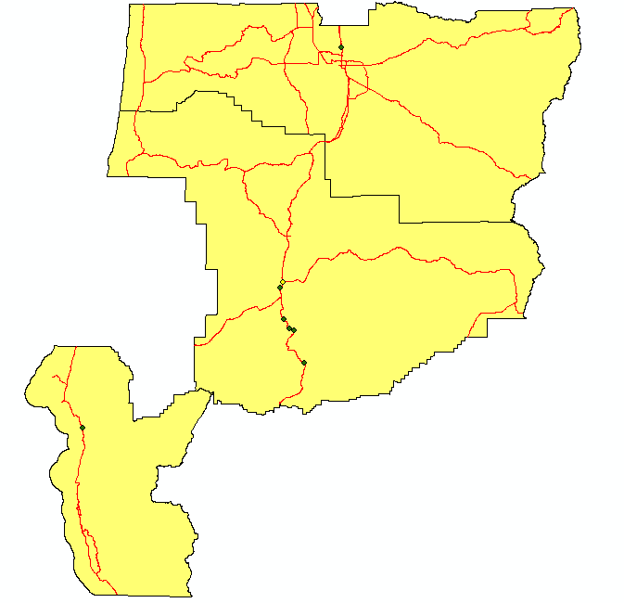

Slide 12
Results
Between the years of 2001-2005, there were 30 landslide events within 100m of highways in Oregon that resulted in repair costs exceeding $1,000,000
The majority of these events were within a price range of $1,000,000 - $3,999,999

Slide 13
References
USGS. 2014. Oregon: Introduction to Landslide Activities in Oregon. http://landslides.usgs.gov/research/inventory/oregon/ (last accessed December 5, 2015)
Oregon Department of Geology and Mineral Industries. Landslide hazards in Oregon. http://www.oregongeology.org/sub/Landslide/Landslidehome.htm (last accessed December 5, 2015)

