Slide 1
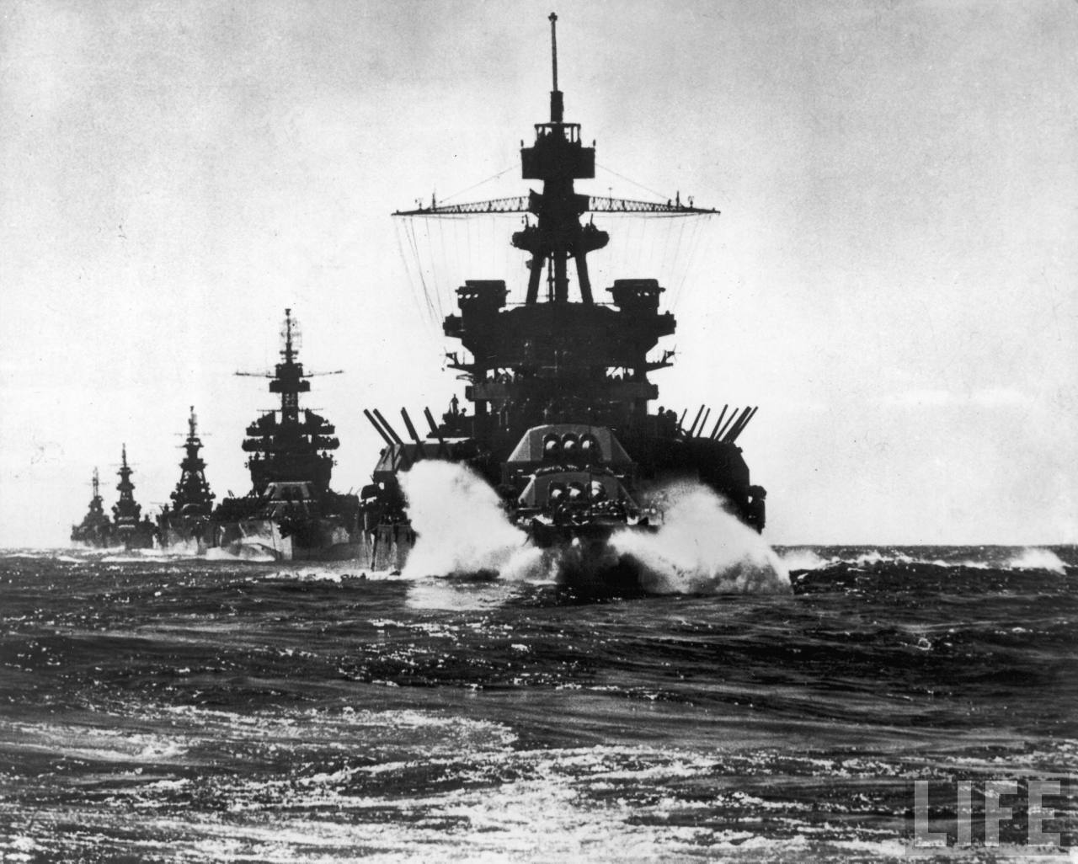
Battle of Leyte Gulf
By: William Bartholomew

Slide 2
Setting
Leyte Gulf is considered the largest naval battle of WWII and potentially in the history of the world
October 23-26, 1944
In 1944, Allied leaders began to focus their efforts on liberating the Philippines from Japanese control. Therefore the U.S. planned for an amphibious assault on October 20 on the island of Leyte in the Philippines
The Japanese became aware of the Allies intentions for the Philippines, Admiral Soemu Toyoda initiated Sho-Go 1 (Victory) to block the invasion.

Slide 3
Fleets and Commanders
Allies
Admiral William Halsey- 3rd Fleet
Vice Admiral Thomas Kincaid- 7th Fleet
Vice Admiral Clifton Sprague- Taffy 3
8 fleet carriers
8 light carriers
18 escort carriers
12 battleships
24 cruisers
141 destroyers and destroyer escorts
Multiple submarines/PT boats
1,500 planes
Japanese
Admiral Soemu Toyoda
Admiral Jisaburo Ozawa- Northern Force
Vice Admiral Takeo Kurita- Central Force
Vice Admiral Shoji Nishimura- Southern Force
Vice Admiral Kiyohide Shima- Southern Force
1 fleet carrier
3 light carriers
9 battleships
20 cruisers
35+ destroyers
300 planes

Slide 4
Sho-Go 1
Organized the remainder of Japan’s forces into three separate units.
Vice Admiral Ozawa’s Northern Force was to serve as bait to lure the Allied forces defending the Leyte landings
With the Allies distracted, Toyoda sent 2 separate forces to attack Leyte from the west: the Southern and Central forces
The Southern Force under Vice Admiral Nishimura and Vice Admiral Shima would attack the landings by passing through the Surigao Strait
The Central Force under Vice Admiral Kurita would pass through the San Bernardino Strait and move south through the Philippine Sea to also attack the Leyte landings

Slide 5
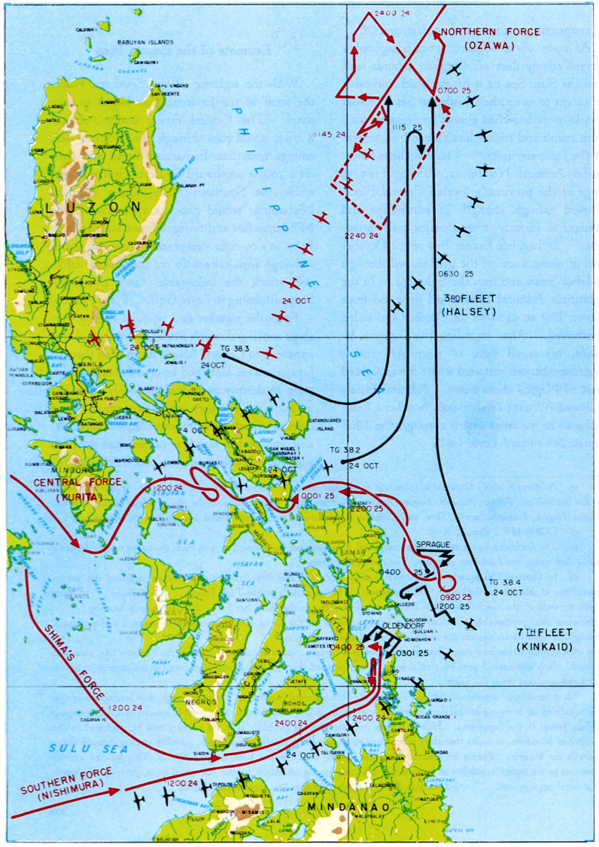
Cape Engaño
Samar
Surigao Strait
Sibuyan Sea

Slide 6
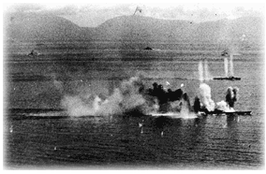
Sibuyan Sea
The first engagement between the Allied and Japanese forces occurred on Oct. 23 in the Sibuyan Sea
As Kurita sailed his Central Force north through the Sibuyan Sea, he was met by U.S. submarines.
In the ensuing confrontation, the Japanese lost two heavy cruisers (Atago and Takao) to submarine torpedoes as well as having a third severely damaged (Maya). Kurita went down with his flagship (Atago) but managed to be rescued by sailors on the Maya and thereafter commanded his fleet from Yamato
Early morning on Oct. 24 the Central Force was spotted by U.S. aircraft which proceeded to begin bombing the fleet, inflicting heavy damage upon it. By the end Kurita had his forces retreat to outside the range of the U.S. aircraft, but returned to his original course that evening

Slide 7
Surigao Strait
On the afternoon of Oct. 24, Nishimura entered the Surigao Strait expecting to unite with the other central Japanese forces
Due to radio silence between them, they were unable to properly coordinate with one another
As Nishimura entered the strait, he found himself targeted by a force consisting of U.S. destroyers and PT boats.
As the Japanese fleet pushed further north through the strait they were met by Allied battleships and cruisers and as a result lost two battleships and a heavy cruiser, forcing the remainder of Nishimura’s forces to withdraw
Later on Shima entered the strait and discovered the wreckage of Nishimura’s fleet, causing him to order an immediate retreat

Slide 8
Cape Engaño
At 4:40 pm on Oct. 24, Admiral Halsey’s scouts located Ozawa’s Northern Force.
Believing Kurita’s forces to be retreating, Halsey saw this as an opportunity to destroy the remaining Japanese forces.
Halsey did not manage to signal Kincaid that he was going out to pursue Ozawa’s force, and as a result, Kincaid was unaware that Halsey had left the San Bernardino Strait virtually unguarded
On Oct. 25, U.S. forces engaged Ozawa’s forces in Cape Engaño, destroying four Japanese carriers and forcing the remainder of Ozawa’s forces to retreat back to Japan.

Slide 9
Samar
Due to the success of Toyoda’s plan, Kurita’s Central Force passed through the San Bernardino Strait and progressed south along the coast of Samar to attack the U.S. landings
Kurita’s force was met by Clifton Sprague’s Task Unit Taffy 3 of Kincaid’s 7th Fleet consisting of escort carriers and destroyers. Although severely outnumbered and outmatched, the U.S. forces desperate air and sea attacks managed to sink 3 Japanese heavy cruisers
Kurita, upon being informed this was not Halsey’s fleet, opted to retreat as the rest of the 7th Fleet began to mobilize on Taffy 3’s location and he knew that the longer he lingered the more likely his forces would come under attack by America aircraft. Kurita’s retreat effectively ended the battle of Leyte Gulf

Slide 10
Losses
Japanese
1 fleet carrier
3 light carriers
3 battleships
6 heavy cruisers
4 light cruisers
11 destroyers
~ 300 airplanes
10,000+ killed
Allies
1 light carrier
2 escort carriers
2 destroyers
3 destroyer escorts
~ 200 planes
~ 3,000 casualties

Slide 11
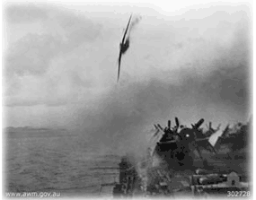
Kamikaze
Leyte Gulf saw the first usage of the Japanese kamikaze tactic
Pilots intentionally crashed their aircraft into enemy vessels in order to inflict heavier damage than conventional weaponry
Reflects a deeply entrenched ideology within the Japanese military of “death over defeat”

Slide 12
Aftermath
The Battle of Leyte Gulf resulted in the destruction of the majority of Japan’s remaining surface fleet, thus ending Japan’s ability to conduct naval operations
At the same time, this battle lead to the liberation of the entire Philippines archipelago, which crippled a crucial oil supply line to Japan

Slide 13
References
“Battle of Leyte Gulf.” United States History. Accessed October 25, 2015. http://www.u-s-history.com/pages/h1757.html
“World War II: Battle of Leyte Gulf.” About.com. Accessed October 27, 2015. http://militaryhistory.about.com/od/worldwari1/p/leytegulf.htm
Michel, Marshall. "The Last Epic Naval Battle: Voices from Leyte Gulf." Air Power History 56, no. 4 (Winter2009 2009): 50-51.
Westphal Jr., Raymond. 2007. "The Battle of Leyte Gulf: The Last Fleet Action." Journal Of Military History 71, no. 1: 267-268.
Muir, Malcolm. 2011. "Book Review: Battle of Surigao Strait. By Anthony P. Tully. Bloomington: Indiana University Press. 2009. 329 pp. £18.99 hbk. ISBN 978 0 253 35242 2." War In History 18, no. 2: 274-276.
Goldstein, Donald M. 2007. "The Battle for Leyte, 1944: Allied and Japanese Plans, Preparations, and Execution." Naval War College Review 60, no. 2: 158-159.
Pulido, Marco A., and Bris a D. López. 2010. "BEHAVIORAL MOMENTUM THEORY AS A GUIDELINE FOR HISTORICAL RESEARCH." Revista Mexicana De Análisis De La Conducta 36, no. 3: 93.
“Battle of Leyte.” Mustard Seed Budget. February 22, 2012. Accessed October 27, 2015. https://mustardseedbudget.wordpress.com/2012/02/22/battle-of-leyte/

