Slide 1
Politics of the Rohingya situation in Southeast Asia
By William Bartholomew

Slide 2
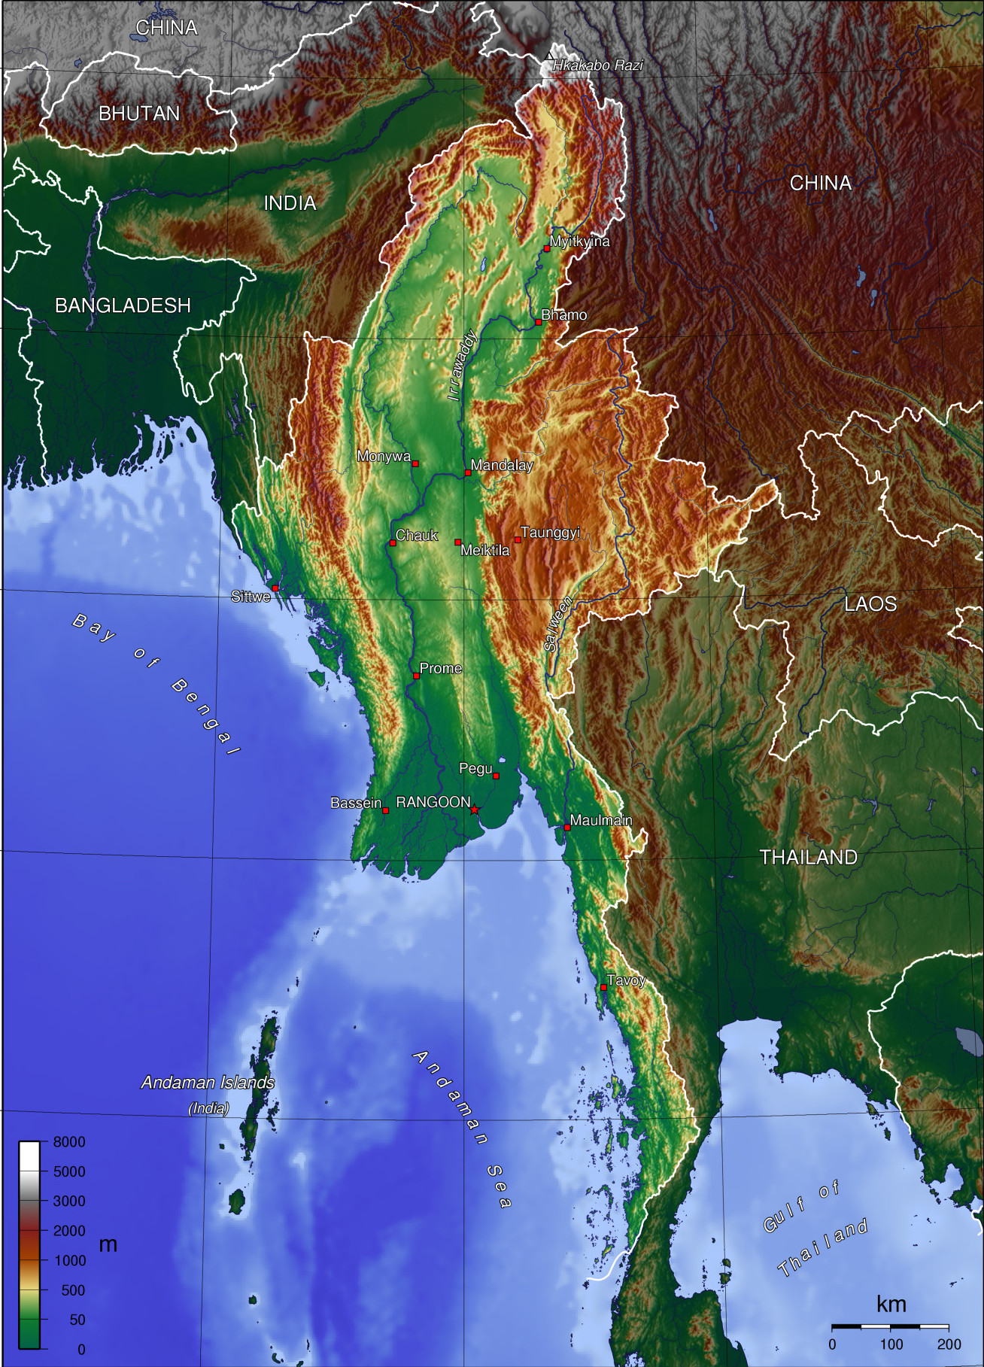
Myanmar/Burma
Located in Malay Peninsula in SE Asia
Total area: 676, 578 sq km
Climate: Tropical monsoon
Terrain defined by centralized lowlands surrounded by rugged highlands
Population: Over 56 million
Ethnicities: 68% Burman, 9% Shan, 7% Karen, 4% Rakhine, etc.
Languages: Burmese (official), Bengali, Shan, Karen, etc.
Seven established states within Burma
https://commons.wikimedia.org/wiki/Atlas_of_Myanmar

Slide 3
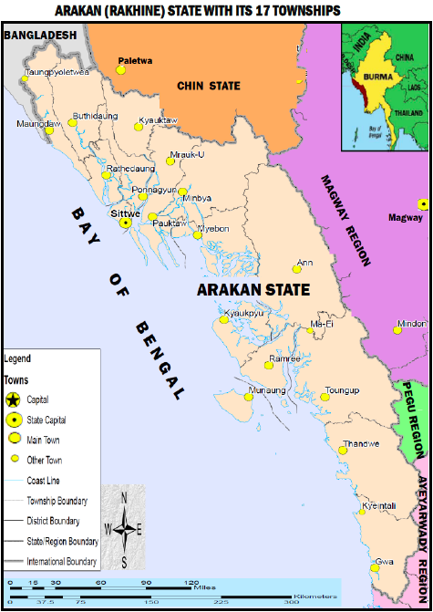
https://commons.wikimedia.org/wiki/Atlas_of_Myanmar
http://ozoutback.com.au/Myanmar/flags/slides/22_Rakhine_State.gif
(Dr. Bahar A. 2012. Racism to Rohingya in Burma)

Slide 4
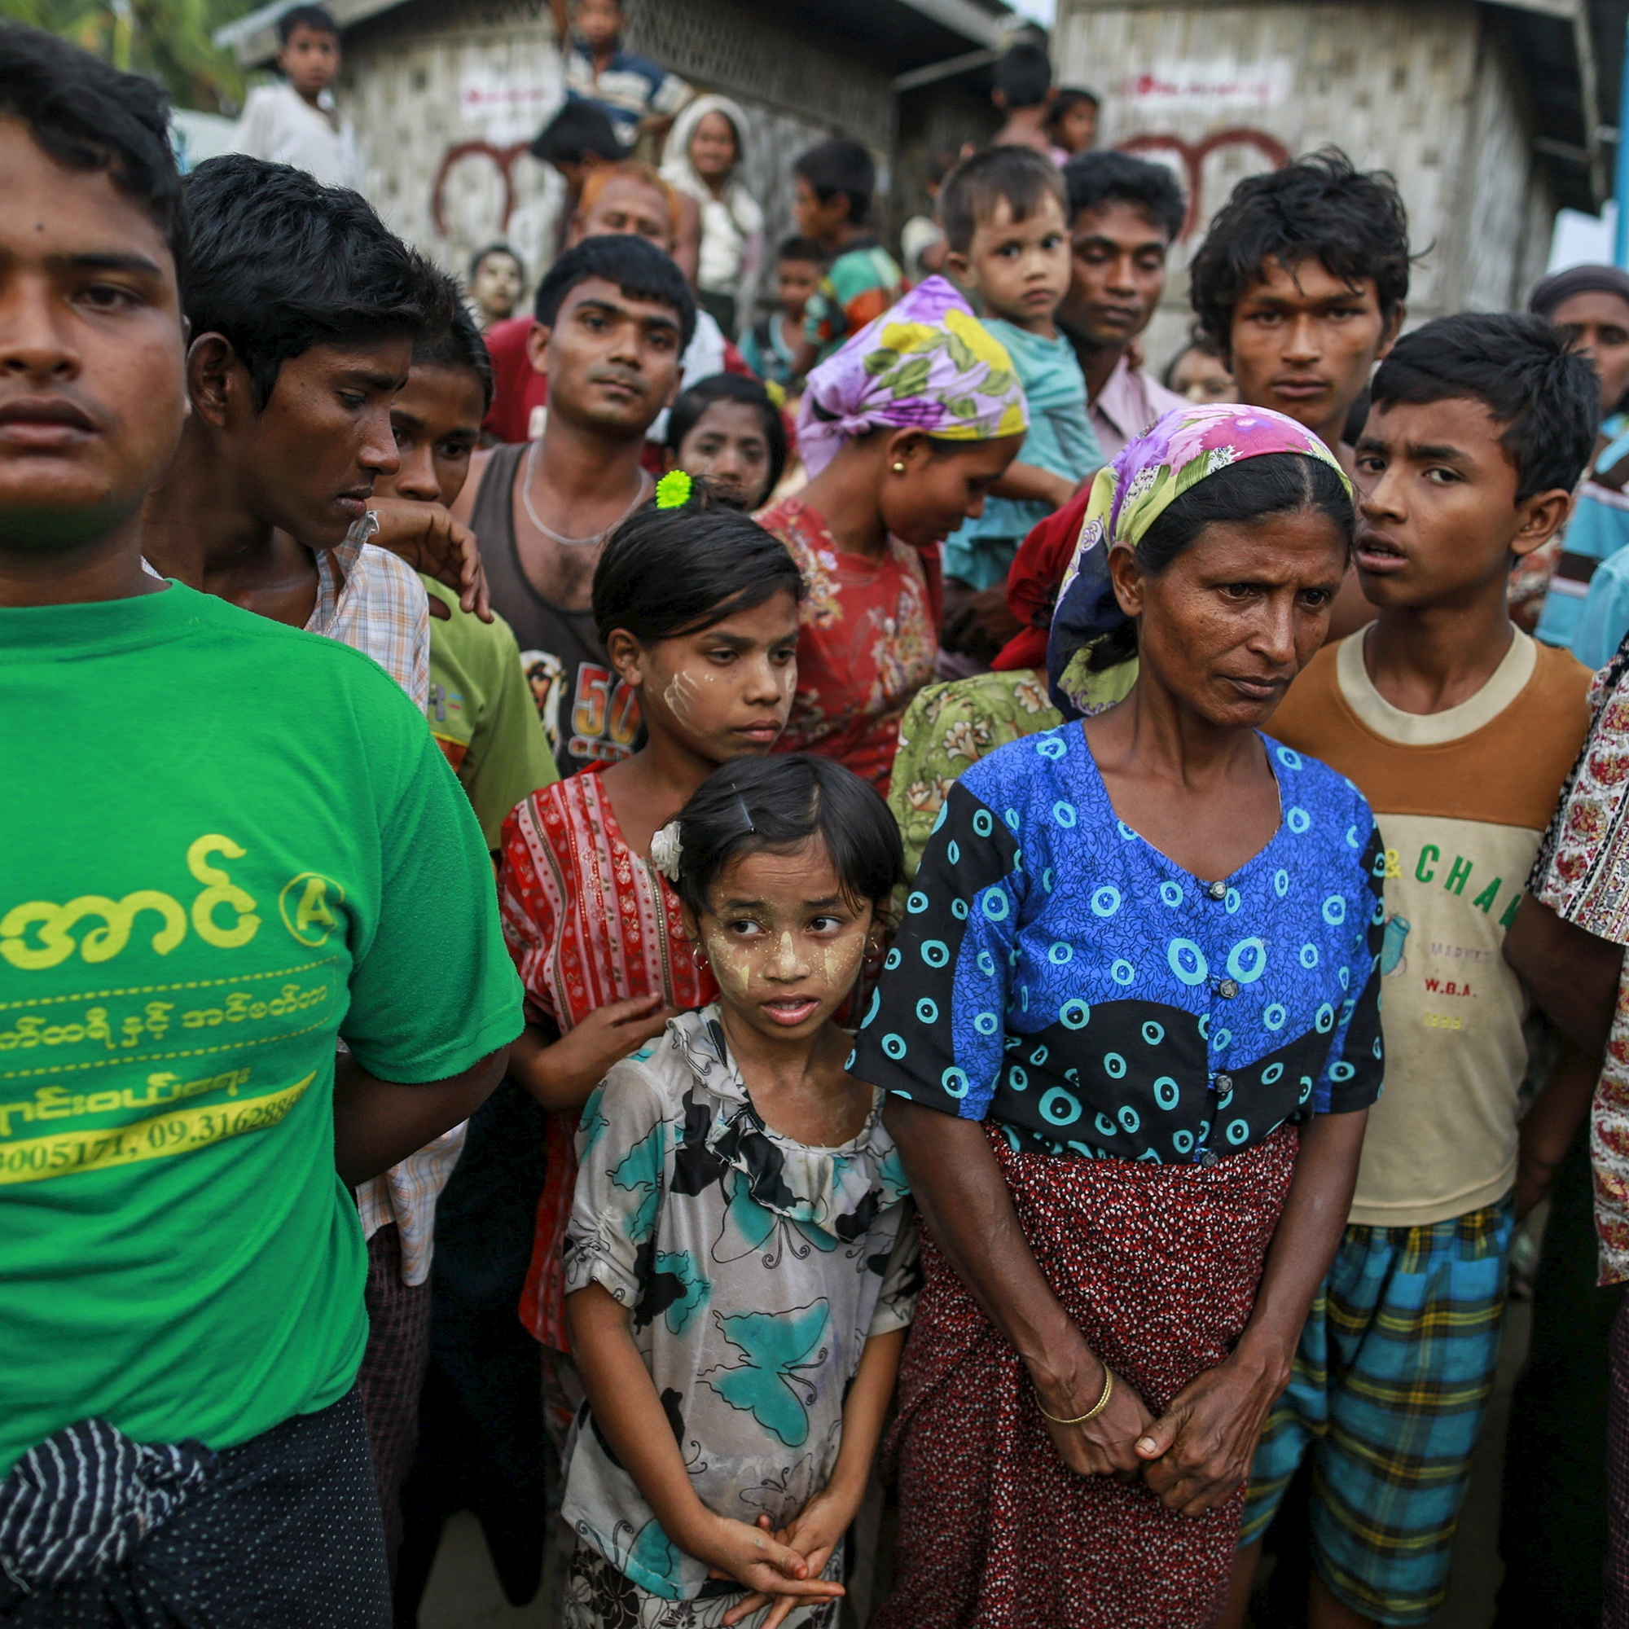
Who are the Rohingya?
The Rohingya are an ethnic minority group who practice Sunni Islam and are mainly located in the northern portion of the Rakhine state of western Burma near the Naf River that forms a border between modern day Burma and Bangladesh.
https://news.vice.com/article/theres-no-chance-that-the-rohingya-people-will-end-up-in-the-gambia

Slide 5
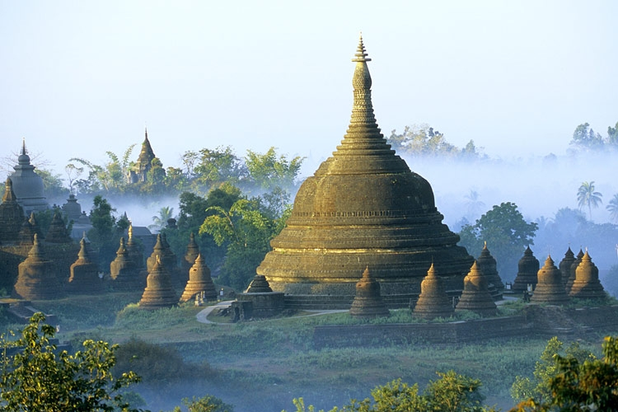
History of Muslims in Burma
15th Century- The independent kingdom of Mruak-U was established by Narmeikhla in northern Arakan
19th Century- A large number of Indian Muslims migrated to Burma as farm labor for rice plantations creating tensions between Muslims and Burmans, mainly due to employment competition
Inter-communal violence between the Rakhine and Rohingya during Japanese occupation of Burma during WWII
http://exoticdestinations.com.au/myanmar/myanmar-tours/the-lost-city-of-mrauk-u-4-days-3-nights/

Slide 6
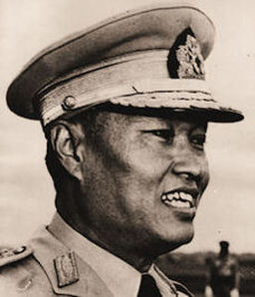
Rohingya lose Citizenship
After Burma’s independence, Muslim leaders attempted to make northern Rakhine an autonomous region
Military coup in 1962 resulted in the new Burmese government adopting the Burmese Way to Socialism
Operation Nagamin (Dragon King) launched in 1977 to address illegal immigration. The Rohingya were a primary target of this operation causing many to flee to Bangladesh
1982 Myanmar Citizenship Law- redefined Burmese citizenship, Rohingyas no longer regarded as citizens
http://www.oxfordburmaalliance.org/1962-coup--ne-win-regime.html

Slide 7
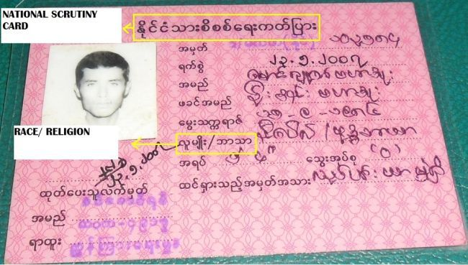
1982 Myanmar Citizenship Law
Introduced three kinds of citizens: full citizens, associate citizens, and naturalized citizens. Rohingya often fall under last two kinds
Limited the number of recognized ethnic groups to 135. The recognized groups are further categorized into eight national races determined by the regions they live in. Rohingya are not one of the recognized groups
http://www.salem-news.com/gphotos/1350504361.jpg

Slide 8
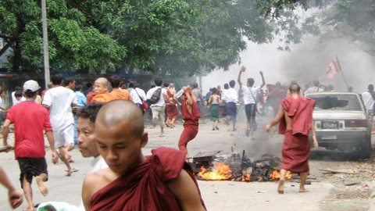
2012 Rakhine Riots
Spark for this period of violence was the murder of a Rakhine Buddhist by a group of Rohingya men on May 28, shortly followed by the murder of ten Burmese Muslims on June 3
Riot groups of Rohingyas and Rakhine Buddhists attacked each other and burned down their houses and places of worship.
Escalated to the point that even neutral civilians were being swept up in the conflict
Burmese government declared a state of emergency and the military was deployed. They managed to settle the worst of the violence, but it returned in its entirety during another wave of riots that began in October 2012
At least 190 people on both sides were killed and hundreds more were injured
http://rlp.hds.harvard.edu/news/communal-conflict-myanmar

Slide 9
The Rohingya Status Today
Rohingyas who wish to wed must obtain permission from the authorities and are limited in the number of offspring they are allowed to have.
Children born to Rohingya parents are no longer issued birth certificates
Rohingyas are extremely limited in their movement outside of their own township, severely limiting employment options and access to government services
Rohingya cannot be employed in any areas of health and education within Burma
After the 2012 riots, tens of thousands of Rohingyas were forced into internment camps throughout the state

Slide 10
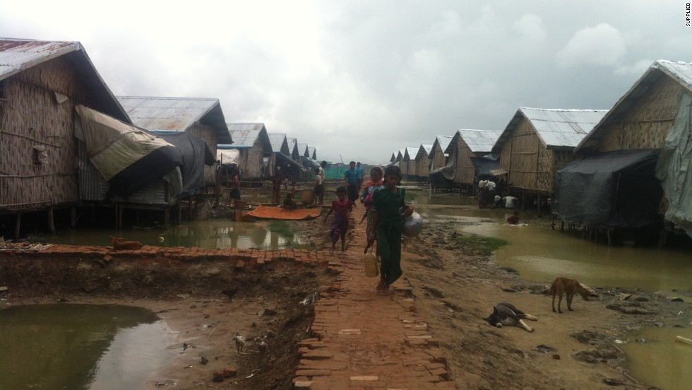
http://www.cnn.com/2014/10/29/world/asia/myanmar-rohingya-action-plan/

Slide 11
Rohingyas outside Burma
20,000 Rohingyas are living in the refugee camps in Bangladesh where they are offered limited protection and assistance by the UNHCR. The Rohingya that live outside these camps, are viewed as illegal migrants by the Bangladesh government
As of 2015, many Rohingya people have been attempting to flee from violence in Burma, often via boats, in order to reach other Southeast Asian countries
Thailand has been known to unofficially deport Rohingya refugees to areas controlled by insurgent groups along the Burma-Thailand border. Rohinyga who cannot afford to be smuggled back into Burma or Thailand are given to human traffickers who then sell them as slave labor for fishing boats and plantations
There is a thriving Rohingya community among the Burmese populations in Kuala Lumpur and Penang. Refugees still run the risk of being arbitrarily arrested and intimidated by the Malaysian police and paramilitary volunteer corps in charge of determining the legitimacy of immigrants

Slide 12
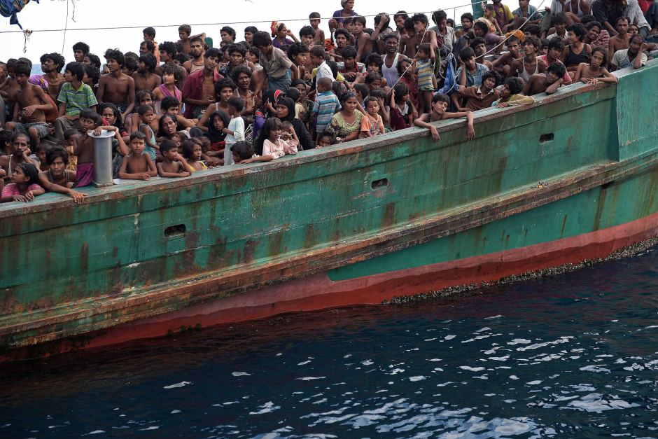

Slide 13
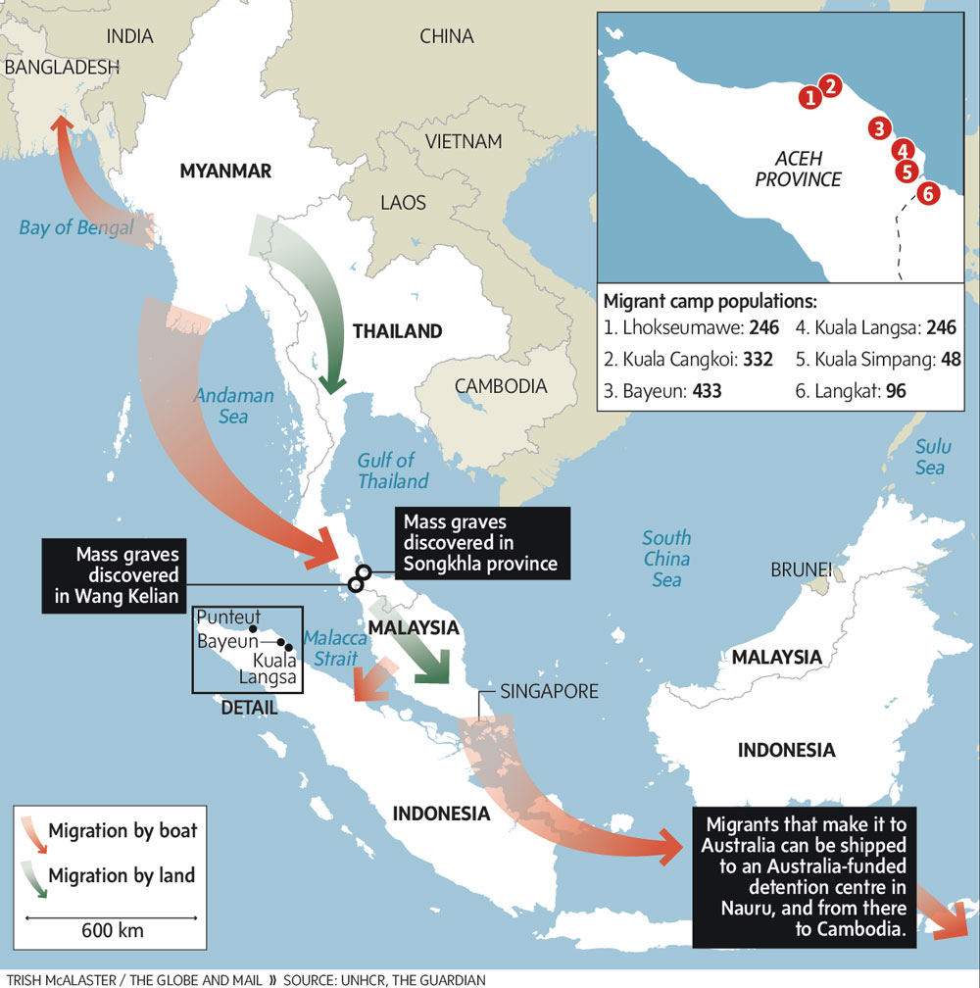
(Vanderklippe. 2015. In transit to nowhere: Rohingya move from one bleak horizon to another)

Slide 14
References
Balazzo P. 2015. Truth & Rights: Statelessness, Human Rights, and the Rohingya. Undercurrent 11 (1): 6-15.
Castles, et al. 2014. The Age of Migration: International Population Movements in the Modern World. New York, U.S.A: The Guilford Press
Central Intelligence Agency. Burma, The World Factbook, https://www.cia.gov/library/publications/the-world-factbook/geos/bm.html (last accessed 11 April 2016)
Chan A. 2005. The Development of a Muslim Enclave in Arakan (Rakhine) State of Burma (Myanmar). SOAS Bulletin of Burma Research 3 (2): 396-420.
Charney M. W. 2005. Theories and Historiography of the Religious Basis of Ethnonyms in Rakhaing (Arakan), Myanmar (Burma). Paper presented at the Workshop.
Holmes A. R. 1967. Burmese Domestic Policy: The Politics of Burmanization. Asian Survey 7 (3): 188-197.
Human Rights Watch (HRW). 2009. Perilous Plight: Burma’s Rohingya Take to the Seas, https://www.hrw.org/sites/default/files/reports/burma0509_brochure_web.pdf (last accessed 15 April 2016)
International Crisis Group. 2014. Myanmar: The Politics of the Rakhine State. Asia Report N°261
International Crisis Group (ICG). 2013. The Dark Side of Transition: Violence Against Muslims in Myanmar. Asia Report N°251
Lewa, C. 2009. North Arakan: an open prison for the Rohingya in Burma. Full Migration Review 32: 11-13.

Slide 15
References
Moshe Y. 1972. The Muslims of Burma: A Study of a Minority Group. Heidelberg, Germany: Heidelberg University.
Ragland, K. T. 1994. Burma’s Rohingyas in Crisis: Protection of “Humanitarian” Refugees under International Law. Boston College Third World Law Journal 14 (2): 301-336.
Smith, M. 1995. The Muslim Rohingya of Burma. Paper presented at Conference of Burma Centrum Nederland.
Transparency International. 2015. Corruption Perceptions Index 2014: Results. https://www.transparency.org/cpi2014/results (last accessed 24 April 2016)
United Nations High Commissioner for Refugees. 2014. As thousands continue to flee Myanmar, UNHCR concerned about growing reports of abuse. http://www.unhcr.org/5396ee3b9.html (last accessed 18 April 2016)
United States Holocaust Memorial Museum. 2015. “They Want Us All To Go Away: Early Warning Signs of Genocide in Burma. https://www.ushmm.org/m/pdfs/20150505-Burma-Report.pdf (last accessed 20 April 2016)
United States House Committee on Foreign Affairs (USHCFA). 2014. “H.Res.418- Urging the Government of Burma to end the persecution of the Rohingya people and respect internationally recognized human rights for all ethnic and religious minority groups within Burma.”
Weightman A. B. 2011. Dragons and Tigers: A Geography of South, East and Southeast Asia. Hoboken, NJ, U.S.A: John Wiley & Sons Inc.

